Slide 1
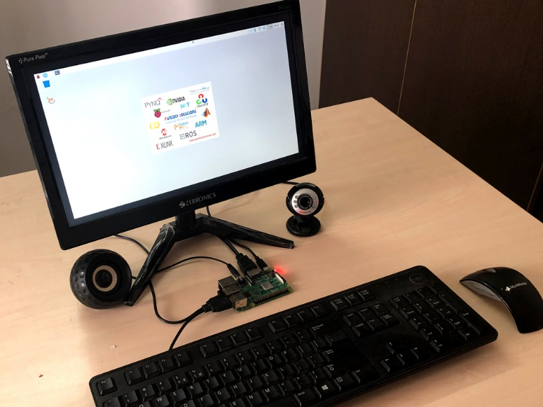
Real-time Object Recognition using deep learning-Raspberry Pi

Slide 2
Introduction
Object recognition is one of the major applications in Deep Learning. It can be done by many ways, like by using Pre-trained model using CNN, Transfer Learning or from the Scratch by feeding n number of datasets to recognize the object with more number of epochs to increase the accuracy of the result.

Slide 3
Abstract
In this project, Object recognition is done by the Pre-trained model MobileNet for recognizing the object with more than 95% accuracy. The model is trained with more than lakhs of images to recognize the object. An object such as Person, chairs, TV Monitor, etc. USB Camera is interfaced with the Raspberry Pi for this application. It can also be done using IP Webcam or Pi camera.

Slide 4
Existing system
In the existing system, object recognition can be done using any of the Image processing Algorithm like SIFT, SURF. But that kind of techniques has lots of limitations, make more difficult to recognize the object.

Slide 5
Proposed System
In the proposed system, deep learning is used. Among that Convolutional Neural Network is used with pre-trained model MobileNet to recognize the object with more accuracy at real-time.

Slide 6
Picture of the connections

Slide 7
Connection Description
Raspberry Pi is booted with the SDCard, with libraries installed like Keras, Tensorflow backend, numpy, etc. USB camera is interfaced with the Raspberry pi to make it as the real-time object recognition application.

Slide 8
Project Description
In this deep learning project, the Pre-trained model is used, Its accuracy is more than 90%. It can also be customized to recognize other objects using Transfer learning. This MobileNet is depthwise separable convolution, reduces the number of parameters. It is more suitable for vision-based applications where there is less performance power of the system

Slide 9
Hardware Required
Raspberry Pi
USB Camera
SD Card

Slide 10
Software Required
Raspbian OS with libraries installed
SD Card Formatter
Etcher

Slide 11
Result
By using this technique you can recognizea number of objects real-time. In the sight of learning, you will learn to use a pre-trained model to recognize the object. It can be easily modified to recognize the object with a different type of Network such as VGG16, GoogleNet or other, can result in you with different accuracy.

Slide 12
Result 1

Slide 13
Result 2

Slide 14
Result 3

